Slide 1
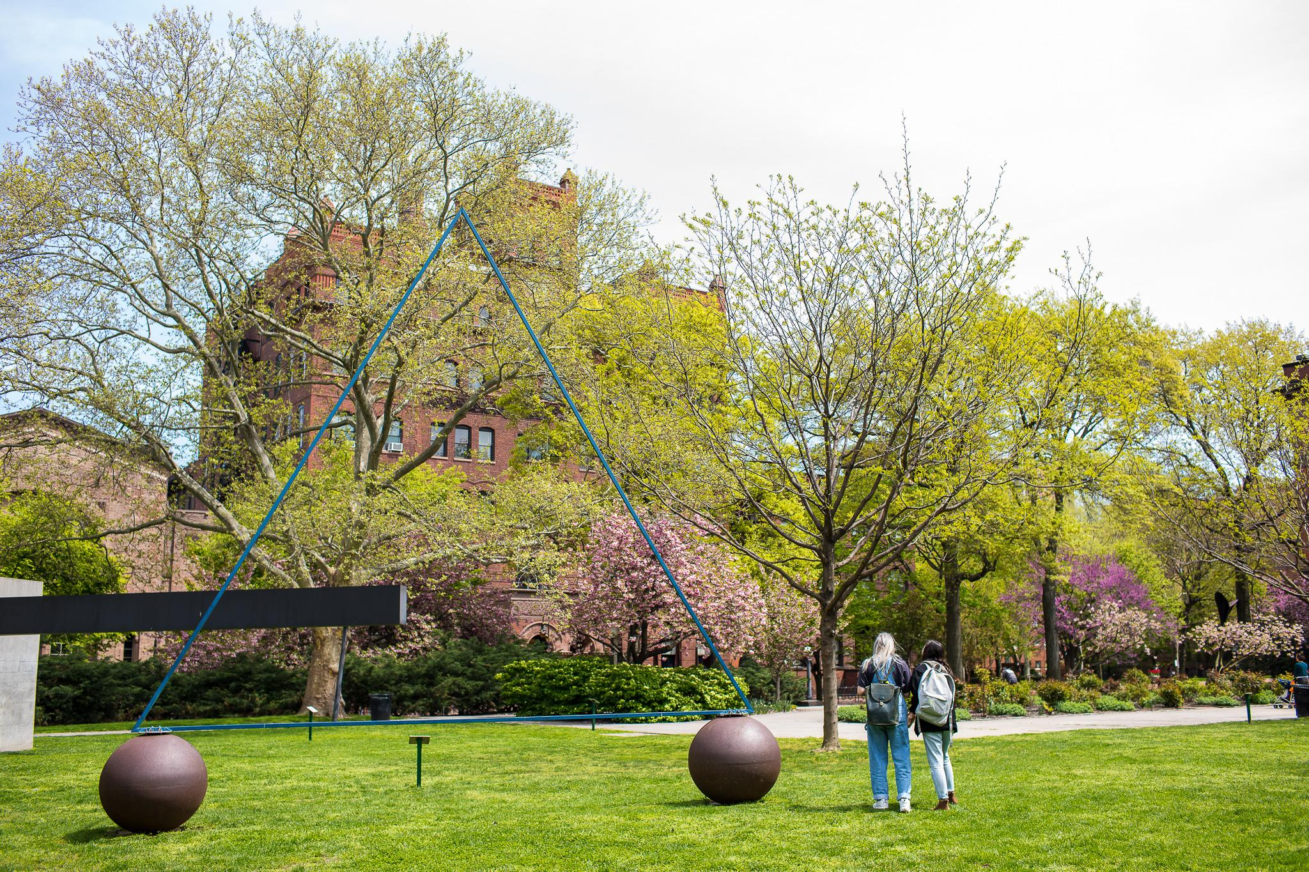

L/AC Faculty Guide Fall 26 - Spring 27
​
Guidance & Information on Accommodations, Services, and
Faculty Support provided by Pratt’s Learning/Access Center​
Notes:
FACULTY GUIDE

Slide 2
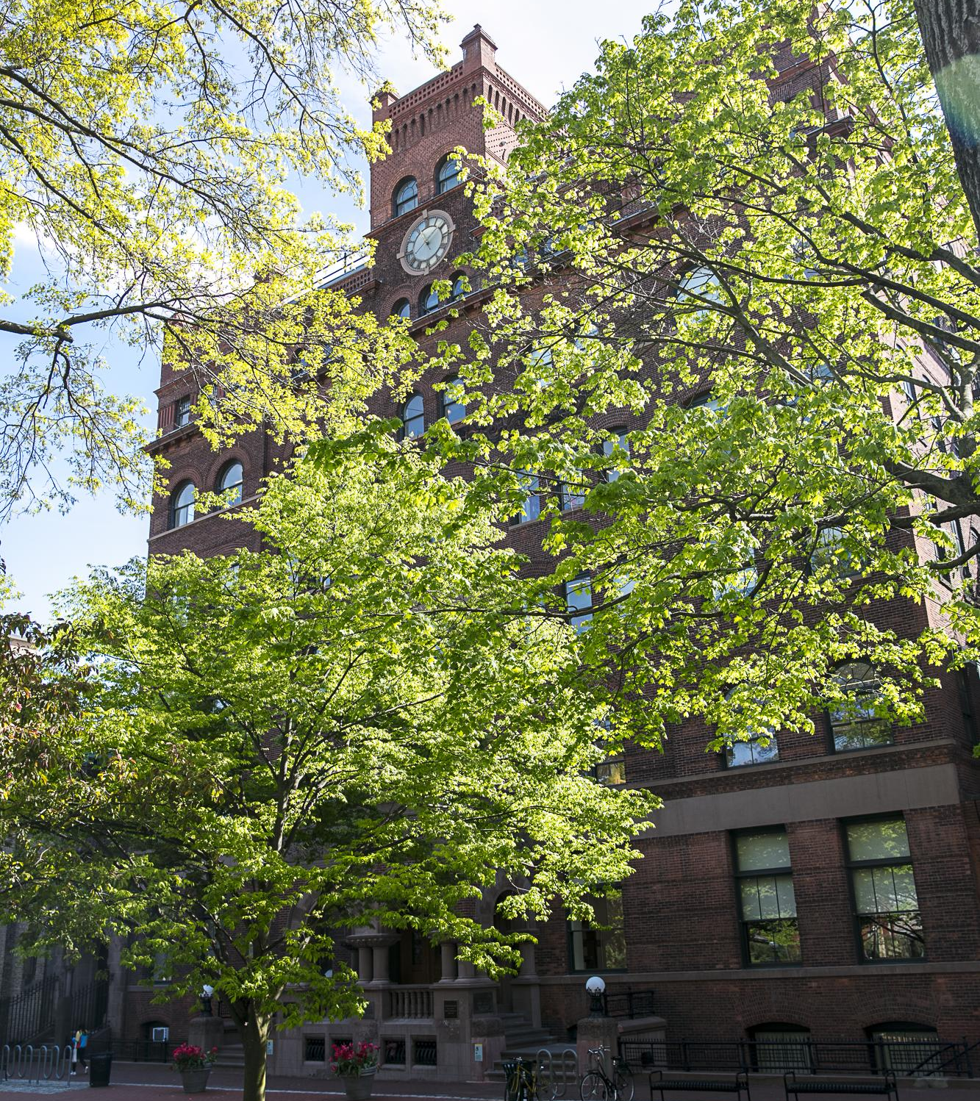

Welcome to Pratt’s
Learning/Access Center
The L/AC staff is excited to invite faculty to collaborate in accommodating Pratt students with disabilities.
To assist the Pratt community in accessing all available resources, we have provided this guide for ensuring accessibility in courses.
If you have any questions, please do not hesitate to contact us by either email lac@pratt.edu or phone (718) 802-3123.
You can also contact Elisabeth Sullivan, Director, at
(718) 636-37611 or esulliv5@pratt.edu.

Slide 3
Contents
Accommodation Process
Starfish and AIM
Application of Accommodations in the Classroom
Disability-Related Absences
Deadline Extensions
Testing Accommodations
Note-taking Assistance
Other Accommodations
Accommodations in the Studio
Service Animals
L/AC Communication Guide
Technology & Tools at L/AC

Slide 4
How Do Students Get Accomodations?
Students seeking accommodations go through the following process:
Provide documentation of disability (from a licensed provider) to the L/AC
Meet with an L/AC advisor for a registration meeting to discuss and
determine appropriate accommodations and provide permission for the L/AC to communicate these accommodations to faculty
Following the meeting and at the start of future semesters, the Faculty Notification Letter (FNL) is sent to current faculty at student request
(This is confidential and the nature of the disability is not disclosed)​
​

Slide 5
Accommodation Process
The L/AC provides a Faculty Notification Letter (FNL) for a student to receive accommodations
Faculty are strongly encouraged to refer students requesting
accommodations to the L/AC to establish consistent and reasonable accommodations for their time at Pratt
There may be occasions when you have concerns about a student and/or the student has made an accommodation request, but they do not have a letter. In these situations, you should refer them to the L/AC through Starfish
Professors should not accept documentation of disability directly from a student. Once a student is referred, the L/AC can determine and establish appropriate accommodations to connect the student with additional support services that may be beneficial

Slide 6
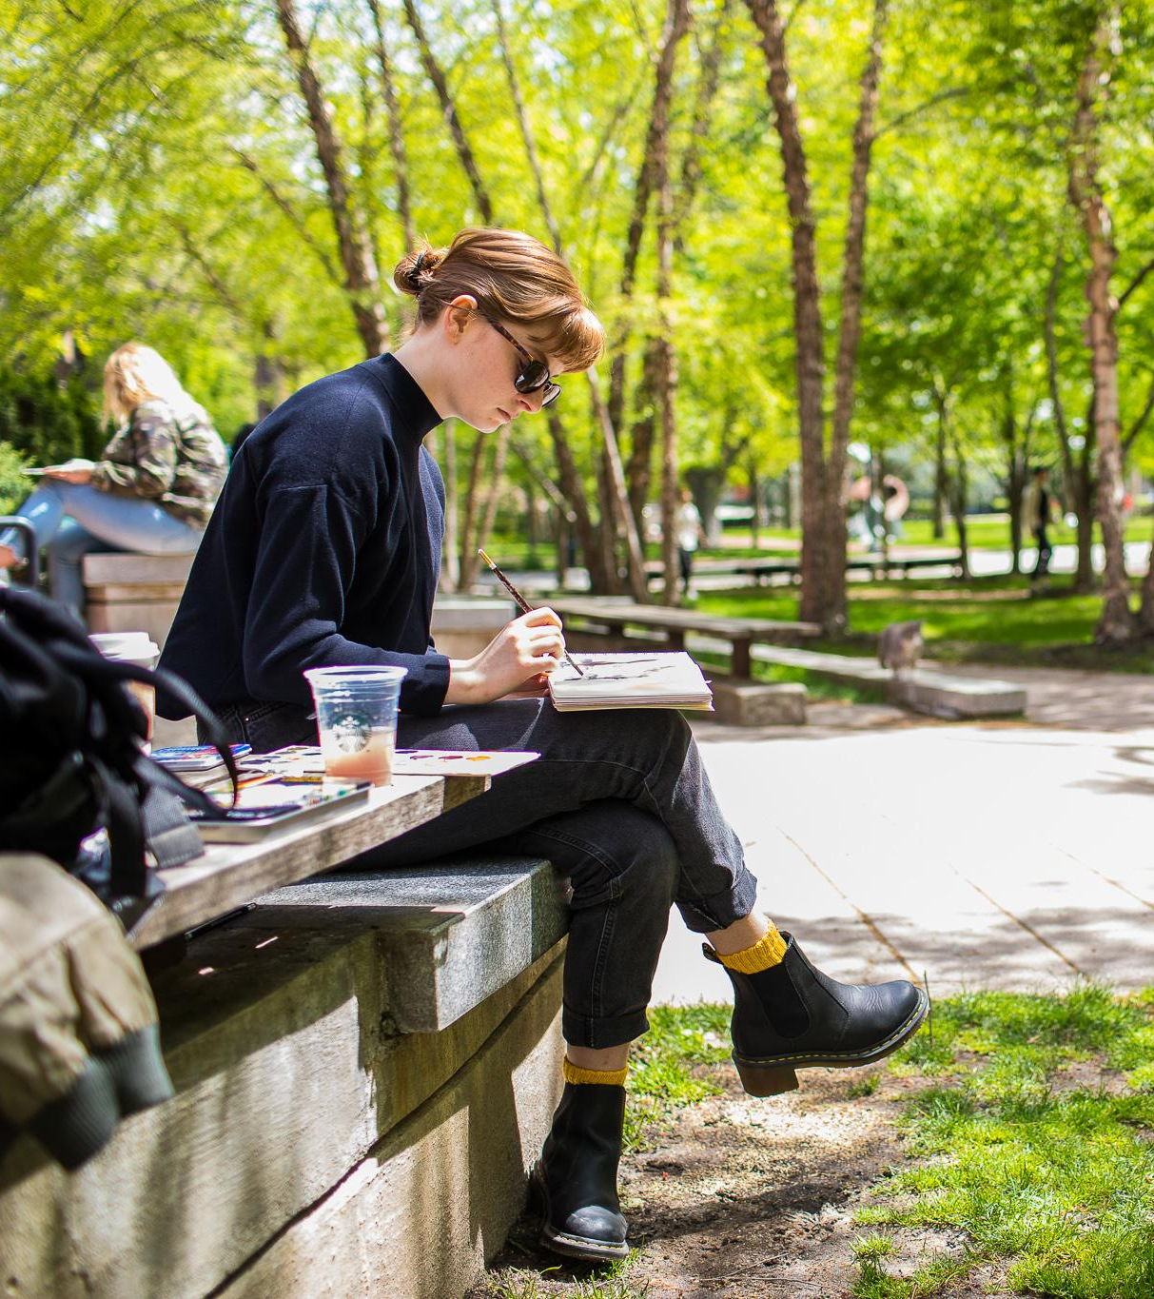
Starfish
Starfish is a student success and retention tool managed by the Student Success Center. It allows faculty to report student needs, and facilitate early intervention and collaboration around student support.
Faculty can raise flags and referrals in Starfish to alert key support offices to student academic or well-being concerns, including a referral to the L/AC to assist a student getting connected for accommodations.
It is often advisable to let students know that you will be raising a Starfish notification. You can review the faculty Starfish guide here.
If you have questions about Starfish, please email starfish@pratt.edu

Slide 7
AIM: L/AC Faculty Portal
The L/AC has an online platform called Accessible Information Management, or, AIM.
AIM allows professors to view accommodations and FNLs for students enrolled in their classes.
AIM is also the tool the L/AC uses for scheduling accommodated exams at the L/AC offices.
Please use the instructor portal to get started (this link
is also found on the FNL emails you receive):
https://teton.accessiblelearning.com/Pratt/instructor

Slide 8
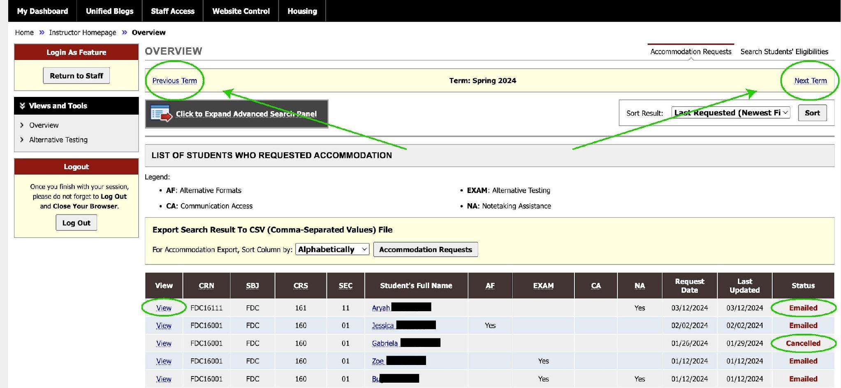
AIM: Instructor Portal Dashboard
Your dashboard displays all L/AC students that are enrolled in your courses
Click “Previous Term’ or “Next Term” to change the semester you’re viewing.
Click “View” to see a student’s accommodations letter (FNL).
If the status reads “Canceled,” this means the student is no longer in
your course.

Slide 9
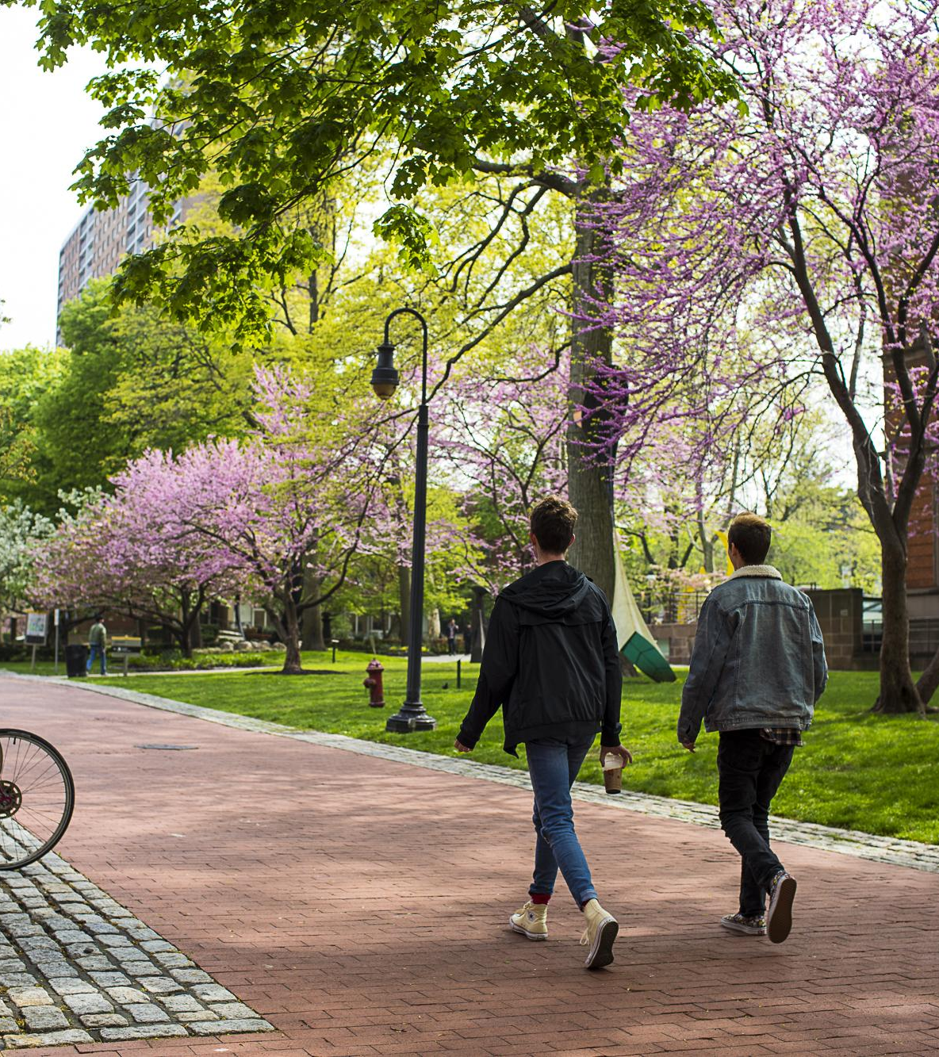
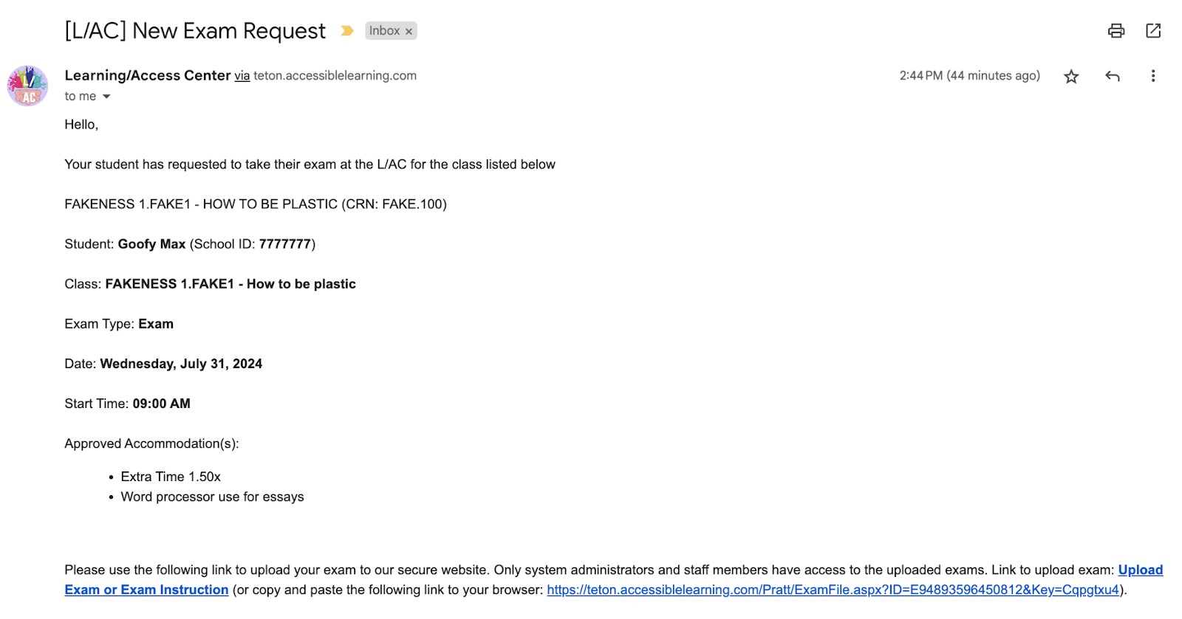
AIM: Alternative Exam Requests
AIM is used for scheduling accommodated exams at the L/AC.
Please contact the Exam Coordinator with any questions or concerns: lac@pratt.edu
If your student would like to take an exam at the L/AC, they can do so by logging into the AIM portal using their Pratt OneKey and navigating to the “Alternative Testing” module. After your student has submitted an exam request, you and the L/AC will receive an email notifying you of the request.
  Click the link at the bottom of the email:

Slide 10
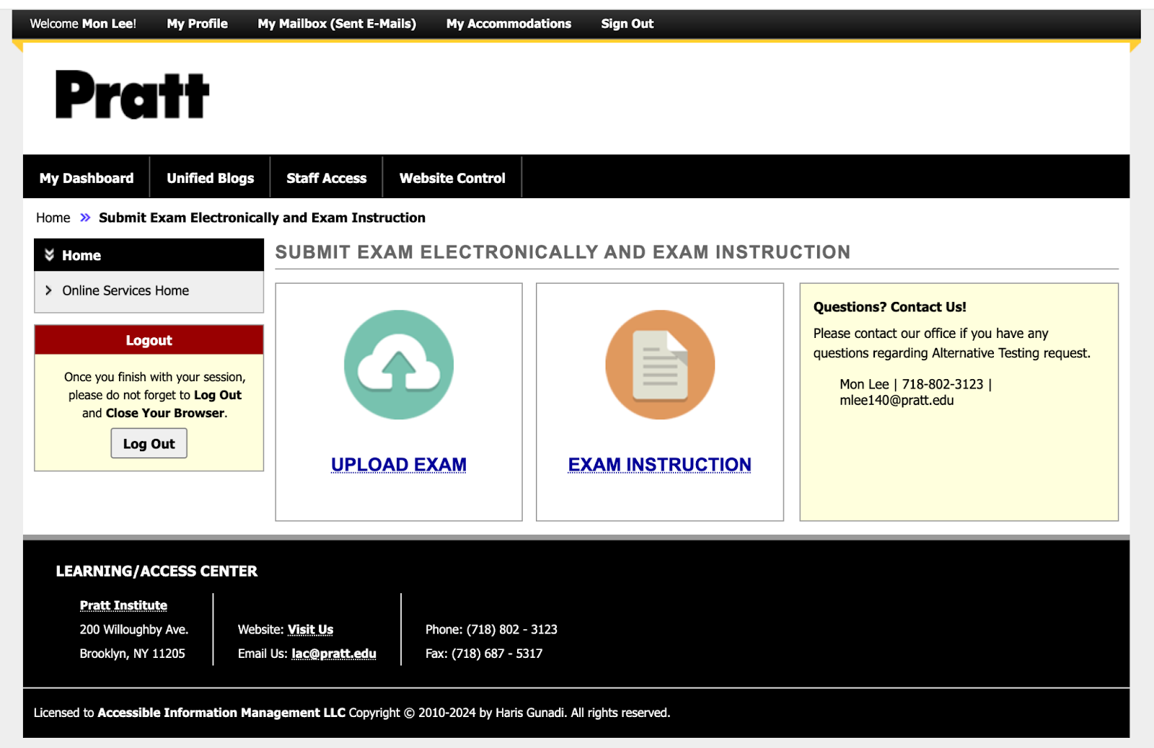
AIM: Alternative Exam Requests
Log into AIM using your Pratt OneKey to access the Exam Upload and Instruction portal:

Slide 11
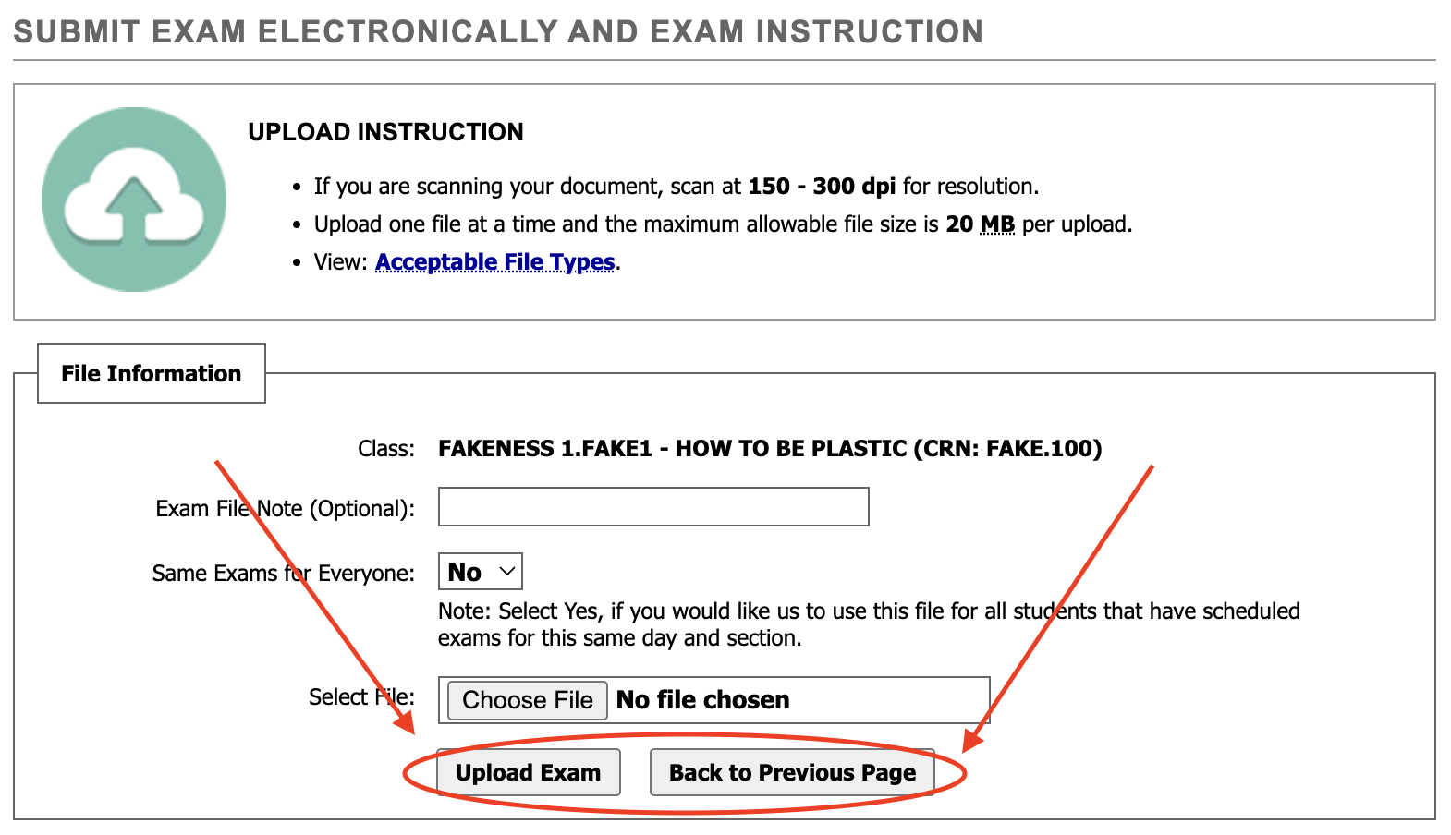
AIM: Alternative Exam Requests
Click the link that says “Upload Exam” to upload the exam file:
After, click the button on the bottom right to navigate back to the “Exam Upload and Instruction” portal

Slide 12
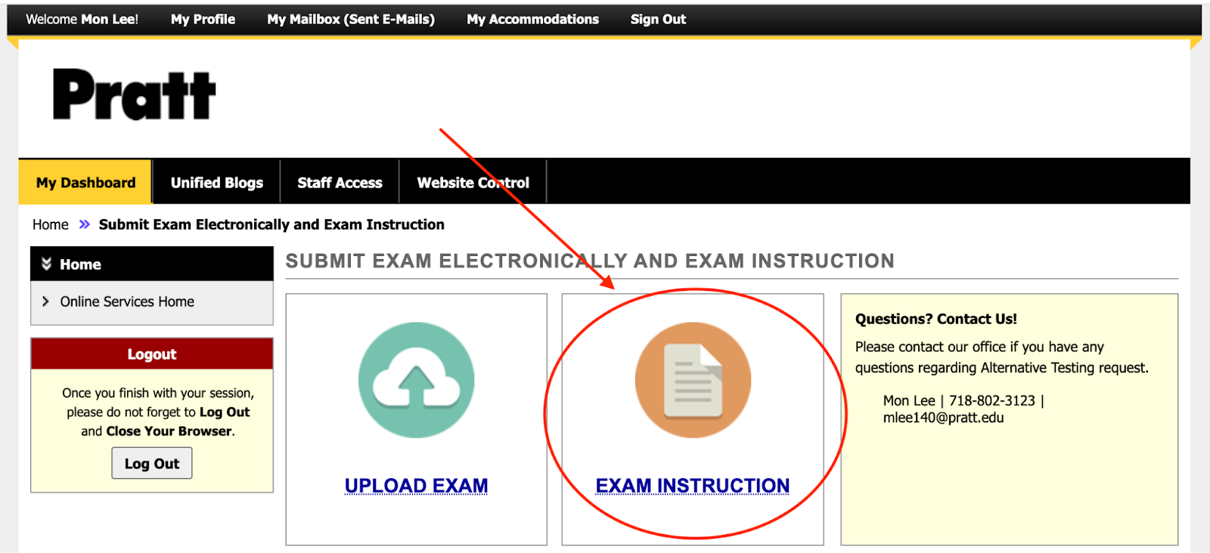
AIM: Alternative Exam Requests
Click the “Exam Instruction” button on the right side and fill out the form:

Slide 13
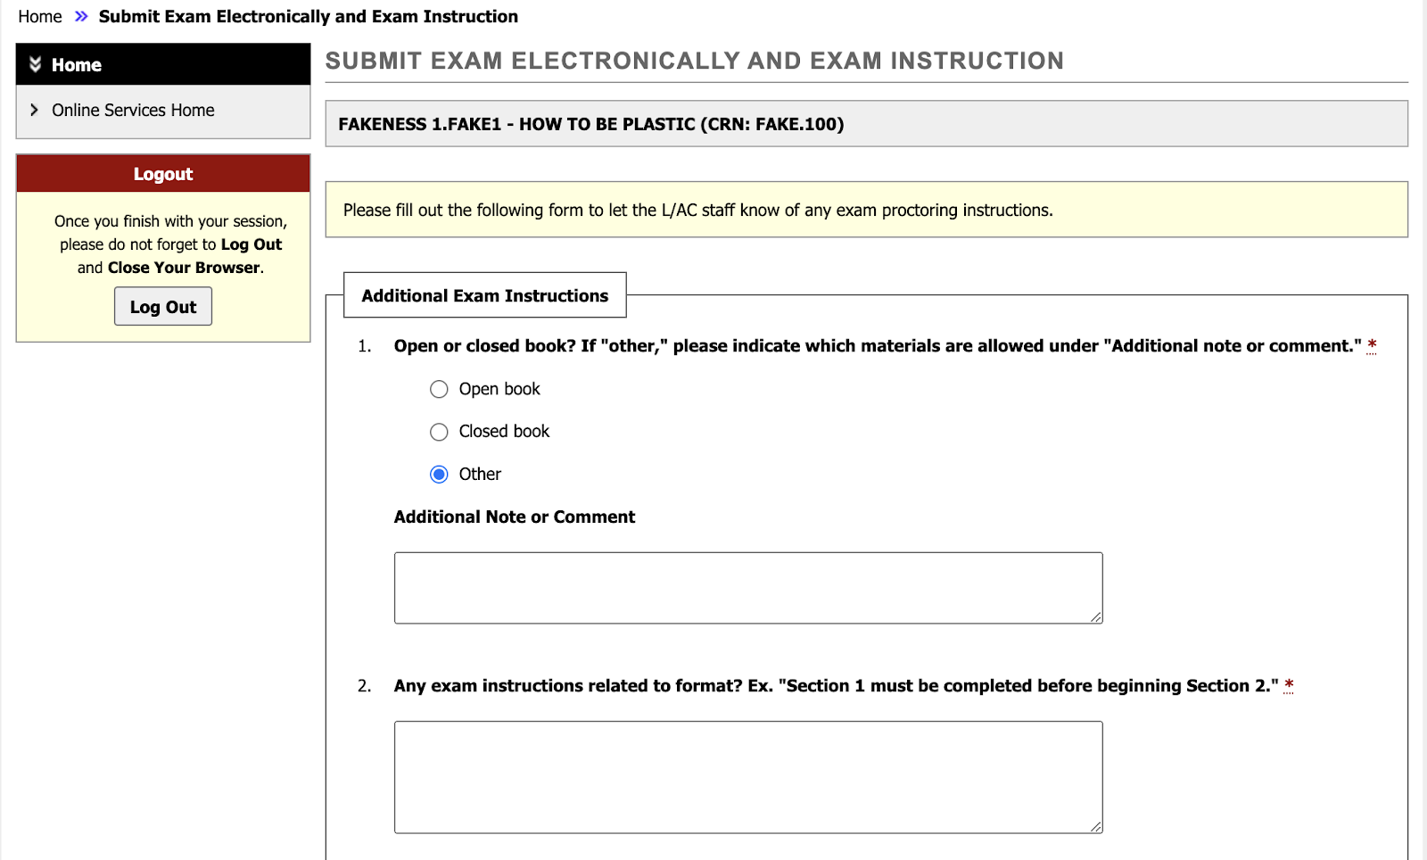
AIM: Alternative Exam Requests
Once the instructions are filled out, click “Submit Exam Instruction” button. You will receive a confirmation message on the screen. You can now exit AIM
Once your student has completed the exam, you will receive an automated email that the exam has been uploaded to the AIM portal. You can download your student’s exam through the portal

Slide 14

Application of Accommodations in the Classroom
Reasonable accommodations may require adjustments to how courses are conducted and/or how program requirements can be met. However, reasonable accommodations are not meant to alter the fundamental nature or the essential learning outcomes of the course or program.
Some accommodations involve more instructor involvement to determine how the accommodations will apply to the course. Students are encouraged to reach out to their instructors once the faculty notification letter has been sent to discuss all of their accommodations.
The following accommodations may involve more extensive conversations and are covered in the following pages:
Disability-related absences
Deadline extensions
Testing accommodations
Note-taking assistance

Slide 15
Disability-Related Absences
When you see this accommodation it means the L/AC office has documentation on file verifying the student’s disability may result in absences, which would be considered “disability-related absences”
The professor should not request additional documentation, such as a doctor’s note, from the student when there is a disability-related absence
We encourage students to communicate clearly with their professors if they experience a disability-related absence by emailing the professor (and copying the L/AC advisor) as soon as they realize they will be absent
A student should not receive an automatic grade penalty for a disability-related absence. However, a student may miss so much instruction that they are at risk of failing. In these cases, the professor should alert the L/AC of this situation via a Starfish flag or other communication

Slide 16
Deadline Extensions
Deadline extensions:
Students with a variety of disabilities may take longer to complete tasks than the average student, which can lead to the need for an accommodation related to deadlines
Students should communicate with their professors regarding any deadline extensions or requests for more time on an assignment or project. We recommend that students email their professors about any such requests and copy their L/AC advisor
If extensions become problematic, professors are encouraged to contact the L/AC advisor with concerns

Slide 17
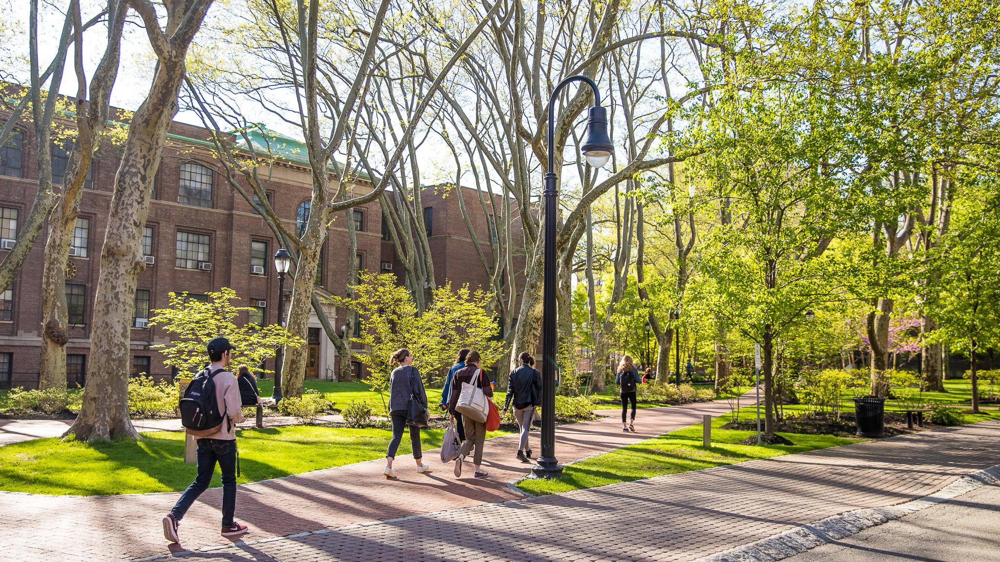
Note-taking Assistance
SmartPen: Some students use SmartPens to take handwritten notes while simultaneously recording linked audio. L/AC lends SmartPens to students
Record on phone: Some students audio record lectures and/or video record demonstrations
L/AC will pursue technology-based note-taking solutions first. However, students may find that notes and materials provided by the instructor can assist with learning
in class. Some options include:
              Lecture notes or outlines used by the instructor
    Lecture slides with speaking notes or outlines used by the instructor
    Zoom recordings of the lecture (advised to provide the transcript as well)
    Audio recordings of the lecture (advised to provide a transcript as well)
    L/AC can work with faculty to determine best options

Slide 18
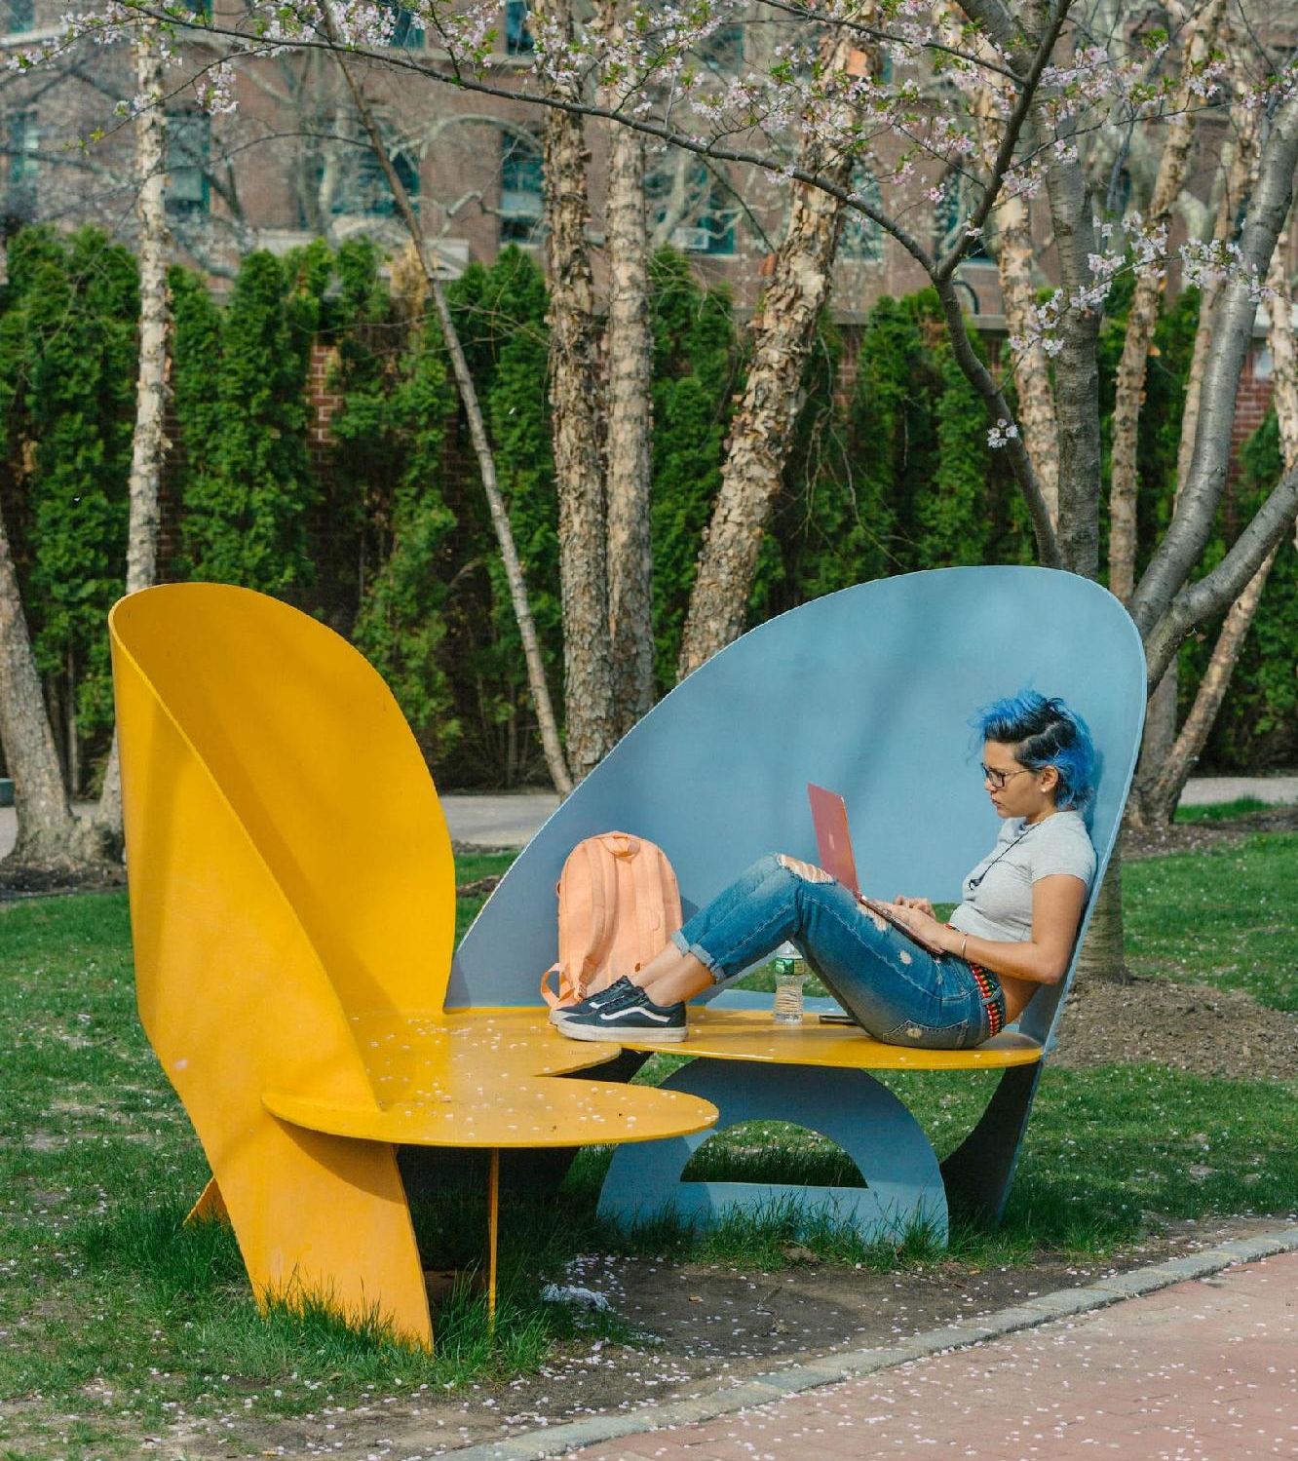
Other Accommodations
Some other common accommodations
you may see included on FNLs:​
Opportunity to take short breaks​
Elevator accessible classrooms and field trips​
Consideration of alternatives for classroom participation​
Alternate format reading materials if requested
​
Assignment instructions in written format

Slide 19
Accommodations in the Studio
The FNL describes standard classroom
accommodations for the student. Certain accommodations, such as extended test time,
may not be applicable in the studio setting, and other accommodations may not be feasible.
If a professor has any questions or concerns about whether a specific accommodation
will alter the fundamental requirements of a studio course, they should contact the student’s L/AC advisor to engage in an interactive
discussion of alternatives with the professor and student.

Slide 20
Service Animals
Under the Americans with Disabilities Act (ADA), if it is not obvious that a dog is a service animal, staff may ask only two specific questions:
Is the dog a service animal required because of a disability?
What work or task has the dog been trained to perform?
Important Considerations:
Staff are not allowed to request any documentation for the dog.
Staff cannot require that the dog demonstrate its task.
Staff cannot inquire about the nature of the person's disability.
In some cases, students will voluntarily request to have information about their service animal presence included on their FNL. Please contact L/AC if you have questions.

Slide 21
        About Accommodations Between Students & Faculty
L/AC Communication Guide:
Strategies for Effective Communication

Slide 22
Importance of Communication
Students appreciate hearing that you support their use of accommodations. A conversation could be in person or via email.
If you need to discuss accommodations with a student in person,
be sure to do so in private.
Communication between professors and students facilitates a mutual understanding of how the accommodations should apply to a class. Discussions about how to implement an accommodation are fine, but if there is an accommodation that you feel is problematic, please contact the L/AC advisor.
The following slides provide a variety of information and resources for faculty and students to facilitate successful communication with each other.
This guide was partly developed in consultation with existing resources and falls under attribution noncommercial share-alike 4.0 International license. for more information on this Creative Commons license, please consult this link some of the information included in these slides may vary from the original source material.

Slide 23
Common Faculty Pitfalls
Students with disabilities are diverse and have different lived experiences of their disability. Unexamined stereotypes and attitudes may impact faculty communication with the student, such as:
    Assigning a heroic status might place a person with a disability on a pedestal, making it difficult for them to assimilate and function
              The myth of “unfair advantage” often does not take into account that the typical college environment (lectures, exams, etc.) often prevents certain students from showing their true potential
    The “spread phenomenon” assumes, from a single disabling condition, that there are also other intellectual, social or physical deficits, limiting opportunities for that student
Successful implementation of accommodations involves the balance
between the students' needs and the essential elements of the course.

Slide 24
Common Faculty Pitfalls (continued)
When discussing accommodations, faculty should avoid the following:
  Engaging in dialogue around disability specifics (e.g., diagnosis, treatment,
  prognosis)
  Minimizing a student's disclosure, failing to refer them to the L/AC, or advising students against disclosure/using their accommodations
  Engaging in microaggressions around disability (e.g., outing students to peers, referring to “special accommodations,” indicating that accommodations are burden)
Students often have little to no experience explaining or expressing their disability-related needs. Many have experienced or witnessed discrimination. The sudden expectation that students with disabilities can now have a conversation with an instructor about their needs and accommodations is sometimes unrealistic.
When students are hesitant to discuss accommodations, it should not be viewed as unwillingness or an attempt to gain some unfair advantage.

Slide 25
Faculty Best Practices
Faculty should observe the following when students disclose their disability:
  Support the student and affirm their experiences as much as possible
  Avoid inquiring into too many details around the disability
  Refer the student to the appropriate offices, most importantly L/AC
Faculty should include the Institutes’ syllabus statement on reasonable accommodations in their syllabi.
Provost Syllabus Template w/ L/AC Stmt

Slide 26
Faculty Best Practices (continued)
Whenever possible, use a Universal Design approach. This type of support puts the emphasis on making the learning environment a seamless and unobtrusive place for all students, both with and without disabilities. Universal design helps to bring diverse learning styles and perspectives into the classroom and campus environment. While disability-related symptoms and barriers are real, a Universal Design approach embraces opportunities to focus on all students’ strengths, rather than problematizing symptoms and deficits.
For more information, see the CAST Universal Design Resource: cast.org

Slide 27
Faculty Best Practices (continued pt.3)
Faculty should avoid these common, but often unintentionally hurtful, verbal microaggressions:
  Using the terminology: “suffers from or confined/restricted to a wheelchair”
  Referring to “special accommodations” or “accommodated test taker”
  Questioning accommodations, “They are not going to get extra time in the real world”
  Threats to “out” the student, "If I'm writing you a recommendation letter, I'll need to include the fact that you used accommodations”
  Using commonplace, albeit potentially offensive phrases such as, “the blind leading the blind” or, “don't have a leg to stand on”
  Attempting to communicate that you “get it,” ”I'm totally OCD about my files!”
  Minimizing: “You have a disability? Which one? It must be mild!”
  Challenging: “You don't have a disability. You're too bright”
  Congratulating students for not needing their accommodations
Notes:
Impact vs intent, sometimes we don’t realize we are saying something that can be hurtful because we don’t mean it in the way it is being heard

Slide 28
Creating an Accessible Class Experience
      L/AC understands that ensuring class materials and experiences are fully accessible and universally-designed can be challenging.
      L/AC serves as a resource to faculty in both interpreting accommodation letters and helping to build the most accessible and disability-inclusive class experiences.
      Please view videos and additional materials on Pratt’s Accessibility Webpage:
      https://www.pratt.edu/about/accessibility/
      Faculty can also use Kaltura:
      https://www.pratt.edu/about/offices/information-technology/kaltura-personal-capture/

Slide 29
Technology & Tools at L/AC
L/AC encourages and endorses the exploration of technology and different tools
for assisting with a student’s disability-related needs. Some commonly used technologies available from L/AC are:
SmartPens
iPads w/ Assistive Apps
Grammarly Software
Audio Recorders
Text-to-Speech Software
Alternative Text Services ​
Accessible Communication
Services (captioning tools, CART/ASL)​
Noise-canceling headphones​
Telepresence Robots for Remote Attendance
& Learning (Kubi)

Slide 30
Access Staff
Elisabeth Sullivan, L/AC Director and 504 Coordinator
Anna Riquier, Associate Director of Accessibility
Kris Percival, Assistant Director
Darelle Daniels, Access Coordinator
Matthew Puvogel, Access Specialist
Jeanine Pollard, Accommodations Specialist
Mav Vitale, Exam Coordinator

